Slide 1
Node Js - Getting Started
Amrita University

Slide 2
Hello World Example
var http = require('http'); http.createServer(function (req, res) { res.writeHead(200, {'Content-Type': 'text/html'}); res.end('Hello World!'); }).listen(8080);
The code tells the computer to write "Hello World!" if anyone (e.g. a web browser) tries to access your computer on port 8080.

Slide 3
Node.js Modules
Consider modules to be the same as JavaScript libraries.
A set of functions you want to include in your application.
Built-in Modules
Node.js has a set of built-in modules which you can use without any further installation.
Include Modules
To include a module, use the require() function with the name of the module:
Now your application has access to the HTTP module, and is able to create a server:
var http = require('http');

Slide 4
Create Your Own Modules
Create a module that returns the current date and time:
exports.myDateTime = function () { return Date(); };
Use the exports keyword to make properties and methods available outside the module file.
//Stored the java script file as JavaScript.js in the same folder where server.js file was presented.

Slide 5
Node.js HTTP Module
Node.js has a built-in module called HTTP, which allows Node.js to transfer data over the Hyper Text Transfer Protocol (HTTP).
var http = require('http');
http.createServer(function (req, res) {
res.writeHead(200, {'Content-Type': 'text/html'});
res.write('Hello World!');
res.end();
}).listen(8080);

Slide 6
Read the Query String
The function passed into the http.createServer() has a req argument that represents the request from the client, as an object (http.IncomingMessage object).
This object has a property called "url" which holds the part of the url that comes after the domain name.
'use strict';
var http = require('http');
var url = require('url');
var port = process.env.PORT || 1337;
http.createServer(function (req, res) {
res.writeHead(200, { 'Content-Type': 'text/html' });
res.write('Hello Prakash CSE1' + req.url + '</br>'); // Get the url after the port
var q = url.parse(req.url, true).query;
var txt = q.year + "\n " + q.month;
res.write('Text Query' + txt);
res.end();
}).listen(port);

Slide 7
Node.js URL Module The URL module splits up a web address into readable parts.
'use strict';
var http = require('http');
var url = require('url');
var port = process.env.PORT || 1337;
http.createServer(function (req, res) {
res.writeHead(200, { 'Content-Type': 'text/plain' });
var adr = 'https://www.w3schools.com/nodejs/shownodejs_cmd.asp?filename=demo_url';
var q = url.parse(adr, true);
console.log(q.host); → returns host
console.log(q.pathname); → returns path
console.log(q.search); → returns search query [?filename=demo_url]
var qdata = q.query; → returns an object [demo_url]
console.log(qdata.filename);
res.end('Hello World\n');
}).listen(port);

Slide 8
Write a NodeJS application to validate a simple HTML form

Slide 9
Node.js File System Module The Node.js file system module allow you to work with the file system on your computer. Place the test.html in the same folder
Read
appendFile- appends specified content to a file. If the file does not exist, the file will be created.
'use strict';
var http = require('http');
var fs = require('fs');
var port = process.env.PORT || 1337;
http.createServer(function (req, res) {
fs.readFile('test.html', function (err, data) {
res.writeHead(200, { 'Content-Type': 'text/html' });
res.write(data);
res.end();
});
}).listen(port);
'use strict';
var http = require('http');
var fs = require('fs');
var port = process.env.PORT || 1337;
http.createServer(function (req, res) {
fs.appendFile('sample.txt', 'Hello CSE Node Js!', function (err) {
if (err) throw err;
res.write("SAVED");
res.end();
});
}).listen(port);

Slide 10
Node.js File System Module
The fs.open() method takes a "flag" as the second argument, if the flag is "w" for "writing", the specified file is opened for writing. If the file does not exist, an empty file is created.
The fs.writeFile() method replaces the specified file and content if it exists. If the file does not exist, a new file, containing the specified content, will be created
fs.unlink() method deletes the specified file
//create an empty file named test.txt:
fs.open(‘test.txt', 'w', function (err, file) {
if (err) throw err;
console.log('Saved!');
});
fs.writeFile(‘writeNew.txt', 'Hello Amrita!', function (err) {
if (err) throw err;
console.log('Saved!');
fs.unlink('sample.txt', function (err) {
if (err) throw err;
res.write("Deleted");
res.end();
});
fs.rename(‘test1.txt', ‘renametest1.txt', function (err) {
if (err) throw err;
console.log('File Renamed!');
});

Slide 11
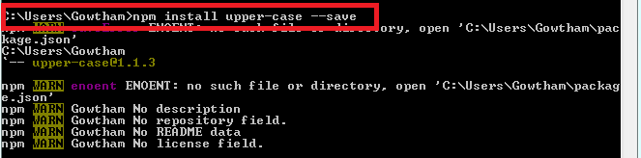
Node.js NPM - NodeJS String Operations
NPM is a package manager for Node.js packages, or modules if you like.
The NPM program is installed on your computer when you install Node.js
A package in Node.js contains all the files you need for a module.

Slide 12
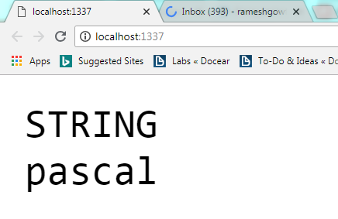
NPM :: Using a Package
var http = require('http');
var upper = require('upper-case');
var port = process.env.port || 1337;
http.createServer(function (req, res) {
res.writeHead(200, { 'Content-Type': 'text/plain' });
var upp = upper('string');
res.write(upp);
res.end();
}).listen(port);

Slide 13
NPM :: Using a Package
Install to-case Package and explore following string operations
Camel
Capital
Constant
Inverse
Dot
Inverse
Pascal
Slug
Use same API to detect the case of specific text

Slide 14
Events Module
To start Node JS Events programming is that import “events” module as shown below:
var events = require("events");
Then use this events variable and create an object of EventEmitter class as shown below:
var eventsEmitter = new events.EventEmitter();
EventEmitter class has a “emit()” function, which is used to create an Event. It takes one parameter.
eventsEmitter.emit(NameOfEventToCreate);
EventEmitter class has a “on()” function, which is used to bind an Event with an Event Handler JavaScript Function. It takes two parameters.
eventsEmitter.on(NameOfEventToBind, EventHandlerFuction);
Here, NameOfEventToBind: We need to pass Event Name a to on() function call as String to bind that event to given Event Handler JavaScript Function.
EventHandlerFuction: Given Event Handler JavaScript Function to handle that event. It may be JavaScript function.
Example
'use strict';
var events = require('events');
var eventEmitter = new events.EventEmitter();
//Create an event handler:
var myEventHandler = function () {
console.log('I hear a scream!');
}
//Assign the event handler to an event:
eventEmitter.on('scream', myEventHandler);
//Fire the 'scream' event:
eventEmitter.emit('scream');

Slide 15
Thanks

